Slide 1

Git basics
Shlomi Alon
July 2022

Slide 2
Agenda
Start to work
Git pull & Git fetch
State of the repository
Staging modifications
Git & Azure Board
Git log & Git diff
Git Reset
Git Revert
Git Branch
Merging branches in Git
Merge Conflicts
Ignoring files

Slide 3
Start to work
Windows:
http://www.git-scm.com
Linux:
apt-get install git
yum install git
Using Git Bash (command line):
$ git config --global user.name "shlom-al"
$ git config --global user.email "shlomi.alon@orbotech.com "

Slide 4
Start to work
Create an empty (sandbox) repository
$ git init /tmp/sandbox.git
Clone the repository
$ git clone file:///tmp/sandbox.git
Start to work in the master branch
$ cd /tmp/sandbox $ git checkout -b master

Slide 5
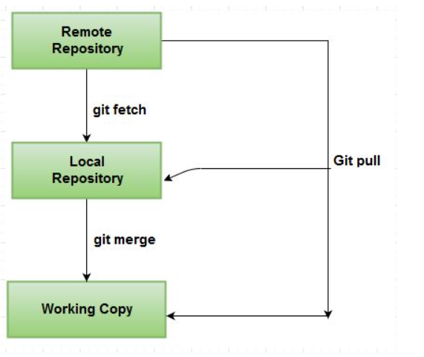
Git pull & Git fetch
Git fetch
Update your local repo from the remote (but don't merge)
Git pull
A git pull is what you would do to bring a local branch up-to-date with its remote version, while also updating your other remote-tracking branches.

Slide 6
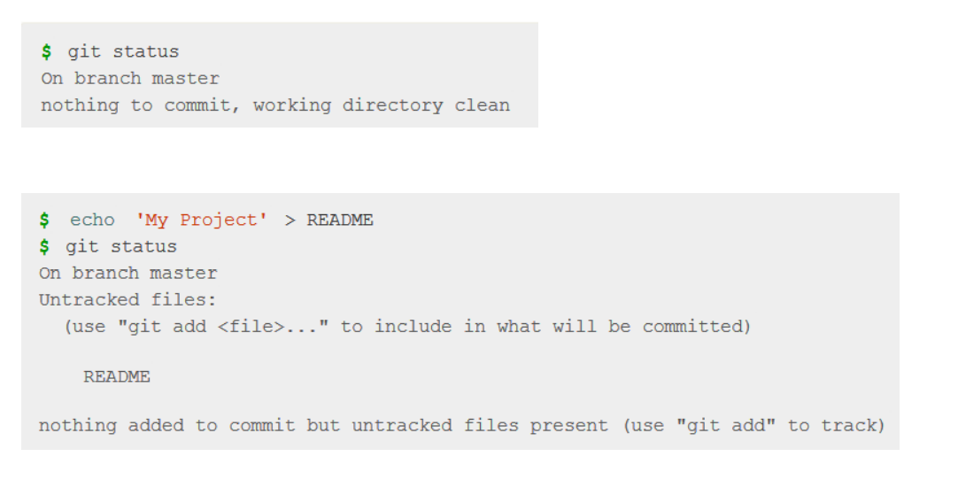
State of the repository

Slide 7
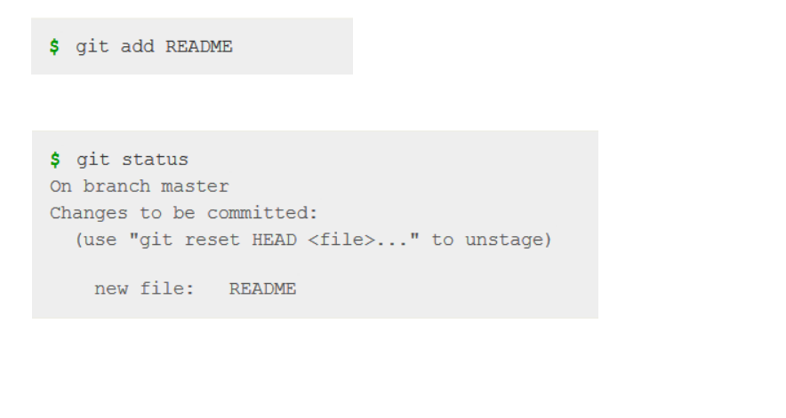
Staging modifications

Slide 8
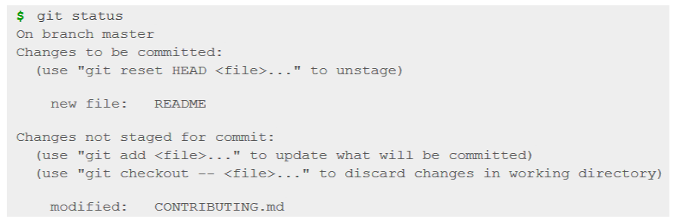
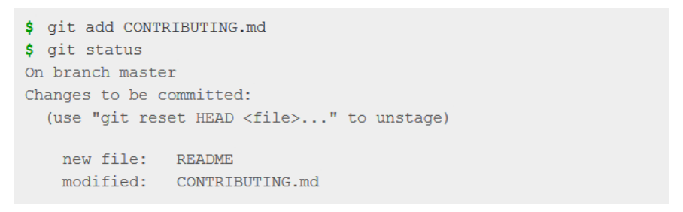
Staging modifications

Slide 9
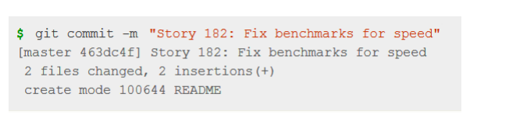
Committing modifications
Commits are a collection of changes that get added to the graph
These are the snapshots that you are able to jump between
You also get to write a message describing what the changes you made were

Slide 10
Git & Azure Board
Git lets you link work items to commits by using the Commit link type. You can do this in several ways:
You can use the git-commit command and include the work item ID in your comment. For example, you apply this comment #35 Catch null exception to your commit. When you push the commit, the system creates a Commit link between the commit and work item #35.

Slide 11
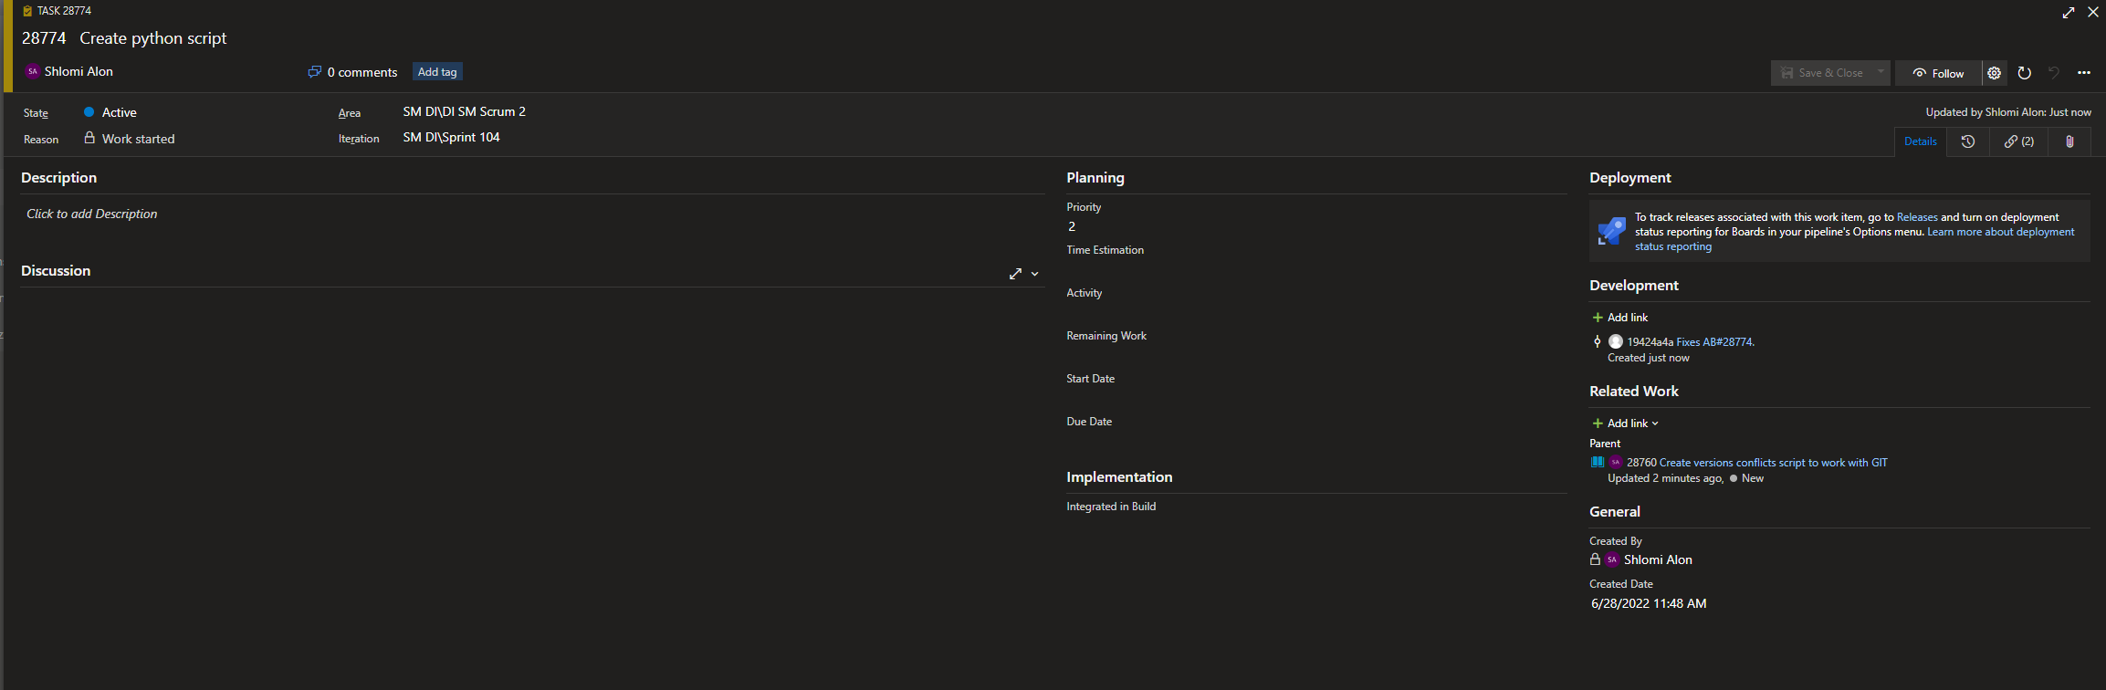
Git & Azure Board - Example

Slide 12
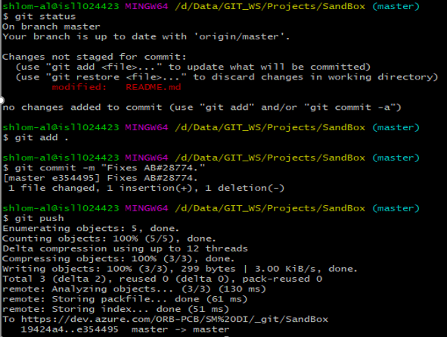
Git & Azure Board - Example

Slide 13
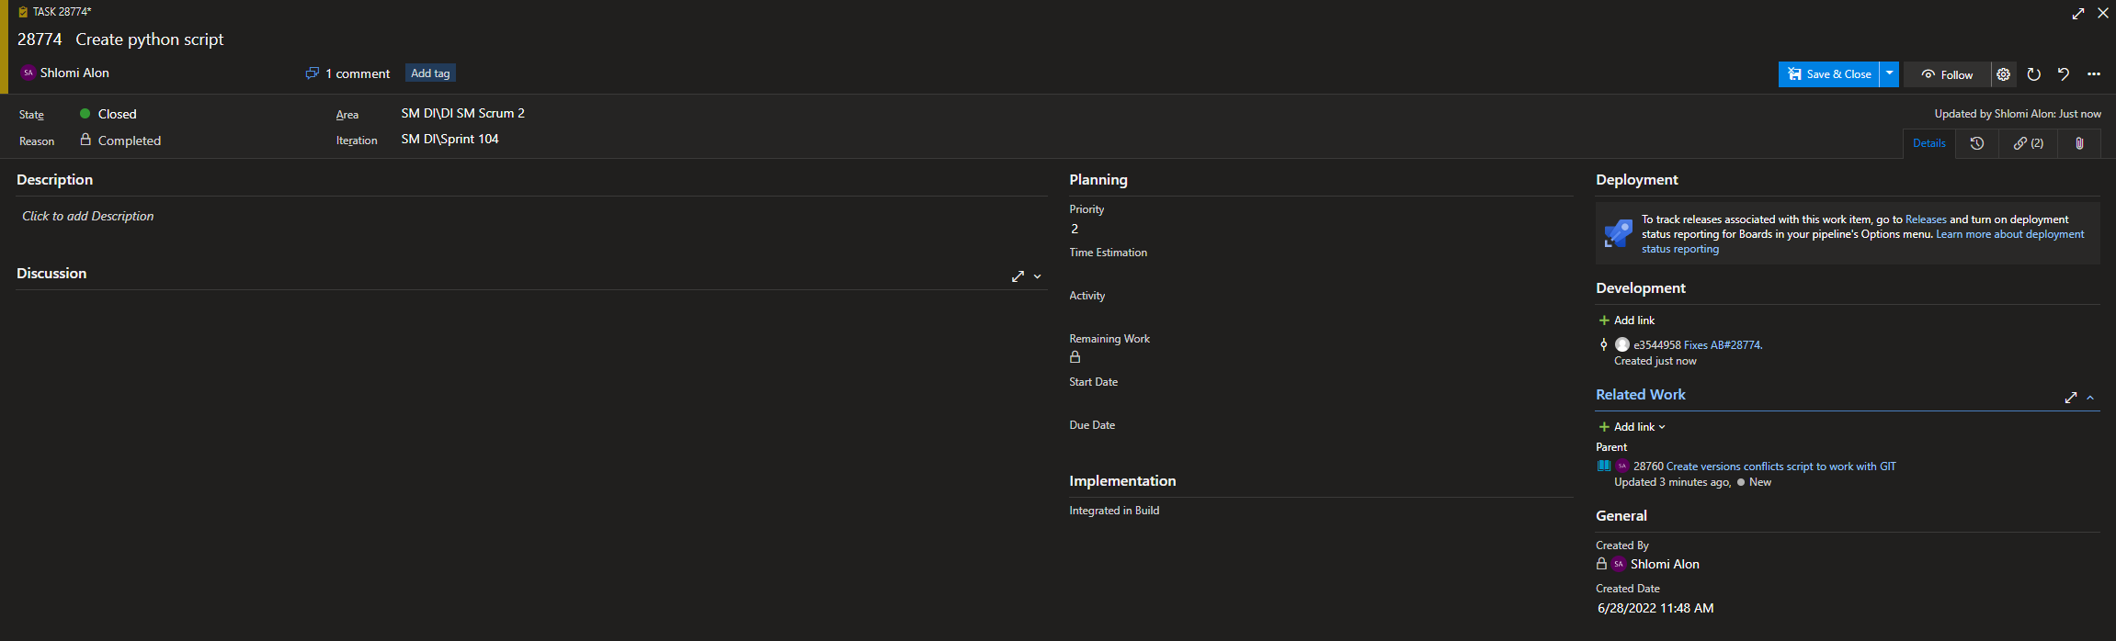
Git & Azure Board - Example

Slide 14
Git log & Git diff
To see a log of all changes in your local repo:
$ git log or
$ git log --oneline (to show a shorter version)
The git diff command helps you see, compare, and understand changes in your project. You can use it in many different situations, e.g. to look at current changes in your working copy, past changes in commits, or even to compare branches.

Slide 15
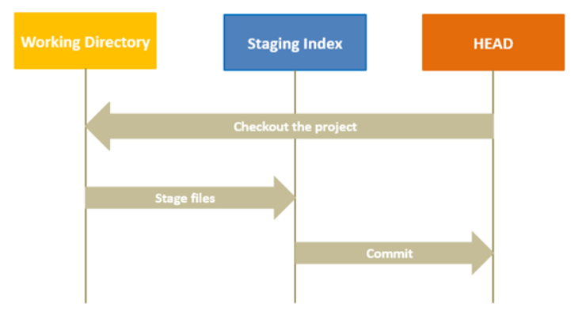
Git Reset
Git reset is a complex command, and it is used to undo the changes.
You can think of git reset as a rollback feature. With git reset, you can jump between various commits. There are three modes of running a git reset command: –soft, –mixed, and –hard. By default, git reset command uses the mixed mode. In a git reset workflow, three internal management mechanisms of git come into the picture: HEAD, staging area (index), and the working directory.
Notes:
The working directory is the place where you are currently working, it is the place where your files are present. Using a git status command, you can see what all files/folders are present in the working directory.
Staging Area (Index) is where git tracks and saves all the changes in the files. The saved changes are reflected in the .git directory. You use git add “filename” to add the file to the staging area. And like before, when you run git status, you will see which files are present in the staging area.
The current branch in Git is referred to as HEAD. It points to the last commit, which happened in the current checkout branch. It is treated as a pointer for any reference. Once you checkout to another branch, the HEAD also moves to the new branch.

Slide 16
Git Reset
Git reset –hard
The purpose of git hard reset is to move the HEAD to the specified commit. It will remove all the commits with happened after the specified commit. This command will change the commit history and point to the specified commit.
Git reset –mixed
In mixed mode (default), the pointer and the staging area both get reset.
Git reset –soft
The purpose of git hard reset is to move the HEAD to the specified commit, but the difference here is, the files of the commits still in my working directory. They have not got deleted. That’s why you should use a soft reset rather than a hard reset. There is no risk of losing the files in the soft mode.

Slide 17
Git Revert
In Git, the revert command is used to perform a revert operation, i.e., to revert some changes. It is similar to the reset command, but the only difference here is that you perform a new commit to go back to a particular commit. In short, it is fair to say that the git revert command is a commit.
The Git revert command does not delete any data while performing the revert operation.

Slide 18
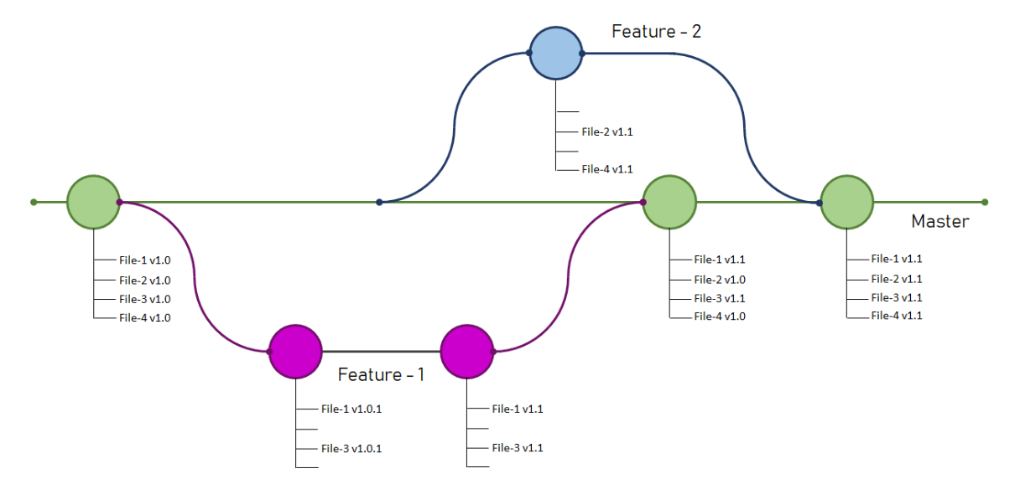
Git Branch
Git Branches allow us to work on different versions of our code simultaneously. Think of branches as alternative timelines.
Git Branches allow us to create separate contexts where we can try new things or even work on multiple ideas in parallel without risking the codebase.
If we make changes on one branch, they do not impact the other branches until we merge or integrate the changes.

Slide 19
Git Branch
If you already have a local branch, you can use
git checkout <name>
If you don’t already have the branch you need, you can create a new branch like this:
git checkout -b <name>
To list all local branch, Pass following command
git branch –a
If you want to List all remote branch, Use
git branch –r
If you want to rename the local branch and you are in the branch which you want to rename mean
git branch -m <new_branch_name>

Slide 20
Merging branches in Git
Once you have finished up some work on a branch and you are ready to integrate it to your main project (or any other branch), you can merge the branch that you worked on into the main branch or any other target branch of your interest. You can also use merging to combine work that other people have done with your own and vice versa.
To merge a branch, branch_A, into another branch, branch_B, switch to branch_A via:
git checkout branch_A
Merge it into branch_B by:
Git merge branch_B

Slide 21
Merge Conflicts
When changes are made to the same file on different branches, sometimes those changes may be incompatible.

Slide 22
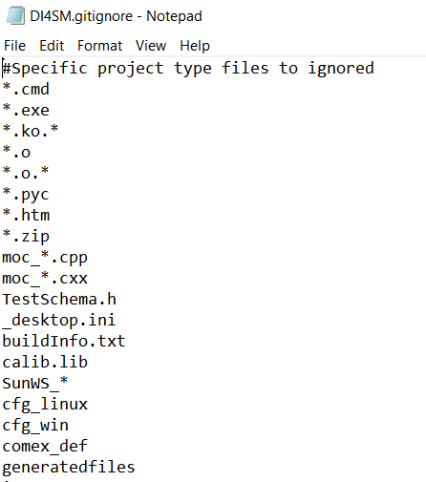
Ignoring files
If we do not want to track automatically generated files (e.g. Log files, build files etc) .gitignore file

Slide 23
Thank You.
Notes:
overview welcome repo

